Slide 1
Do It Tomorrow
Y
Conor Sargent
Colm Mulhall
Daniel Hogan
Robert Lowe

Slide 2
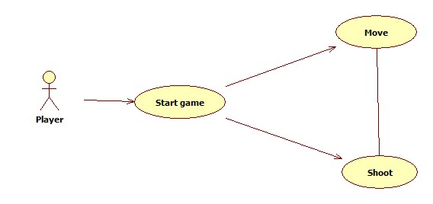
The only user for our system will be a human playing against AI
The player can shoot from the tank and move

Slide 3
We want to modernize the original tank game Battlezone. Using wireframe as additional features and screen cracks to indicate player health.

Slide 4
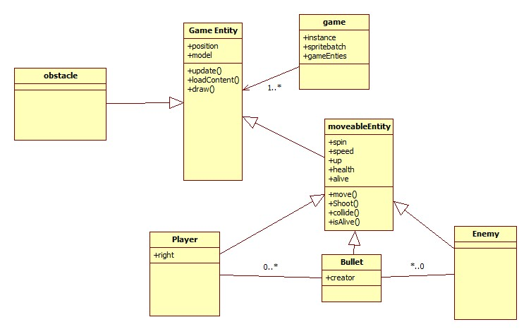
The XNA framework provides us with specific classes like game and game entity.

Slide 5
GUI prototype

Slide 6
Development method
Blender will be used for the 3d modelling.
Coding will be delegated between each team member to maximise output.

Slide 7
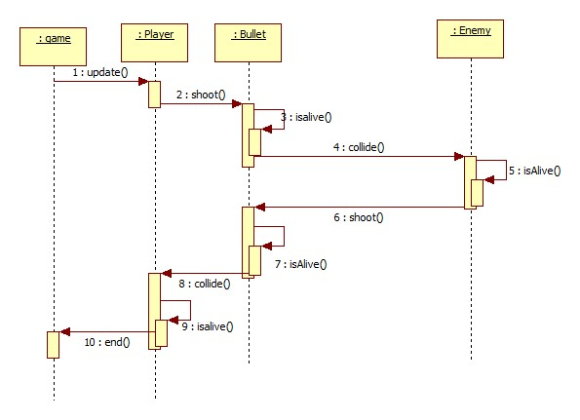
Player shooting interaction

